Slide 1
Javascript-Behind the scence

Slide 2
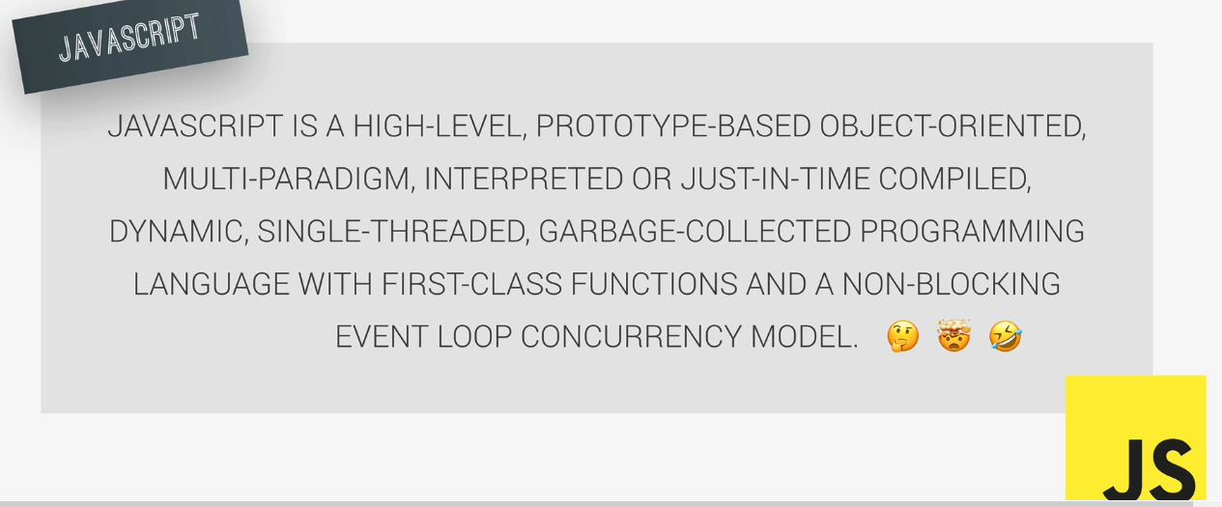

Slide 3
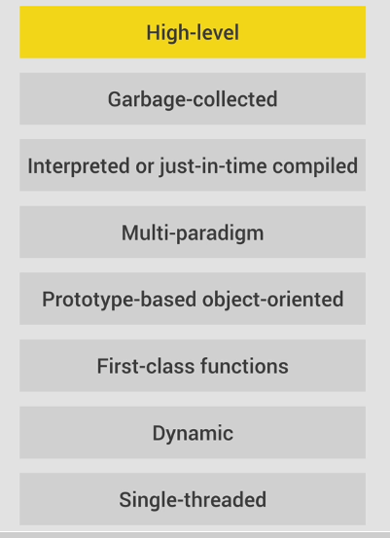

Slide 4
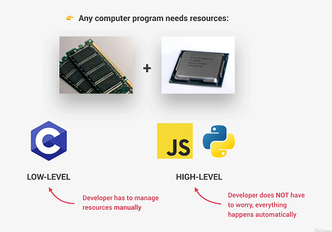
High Level

Slide 5
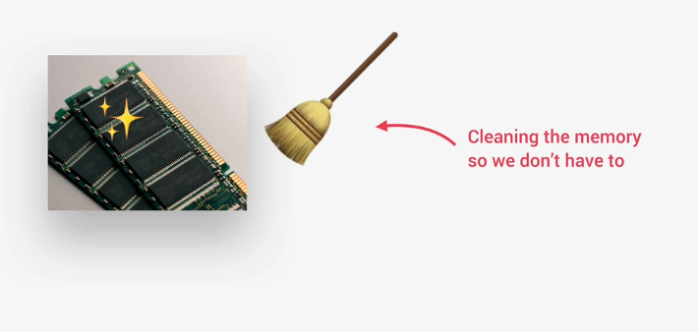
Garbage Collected

Slide 6
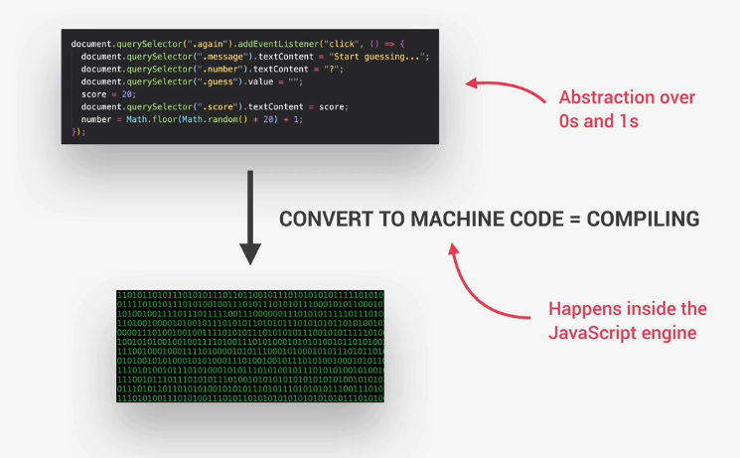
Interpreted – Just-in-time compiled

Slide 7
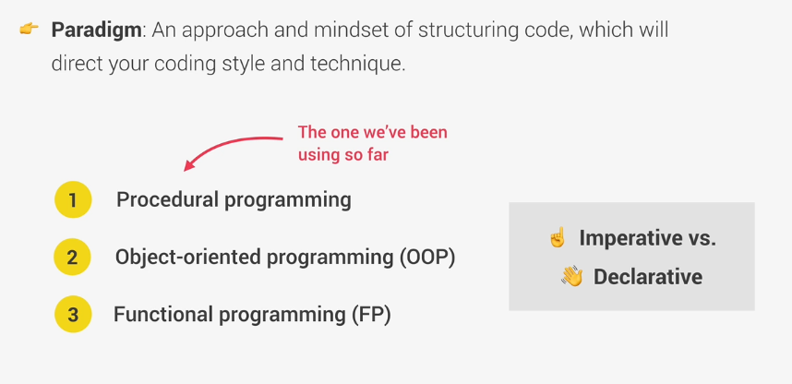
Multi-paradigm

Slide 8
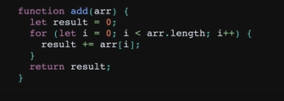
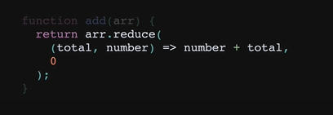
Imperative vs Declarative
Imperative programming
Declarative programming

Slide 9
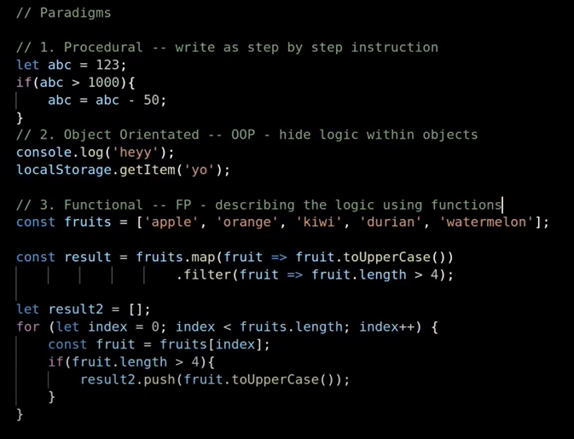
Procedural vs object oriented vs functional

Slide 10
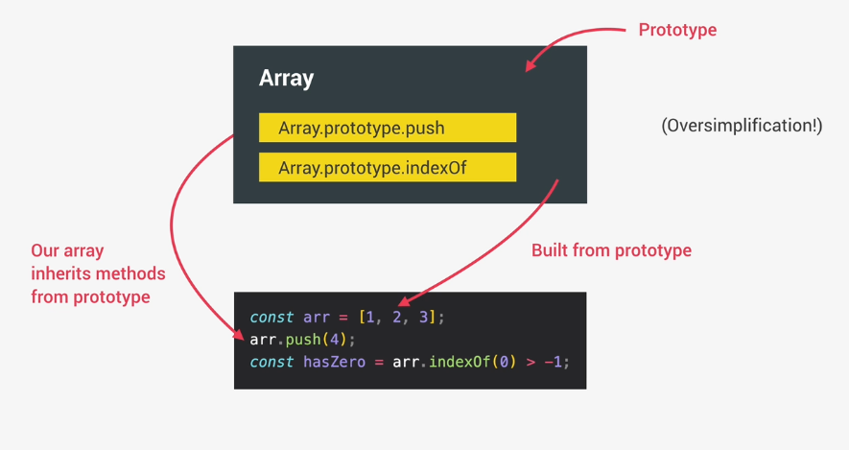
Prototype-based-object-oriented

